Slide 1
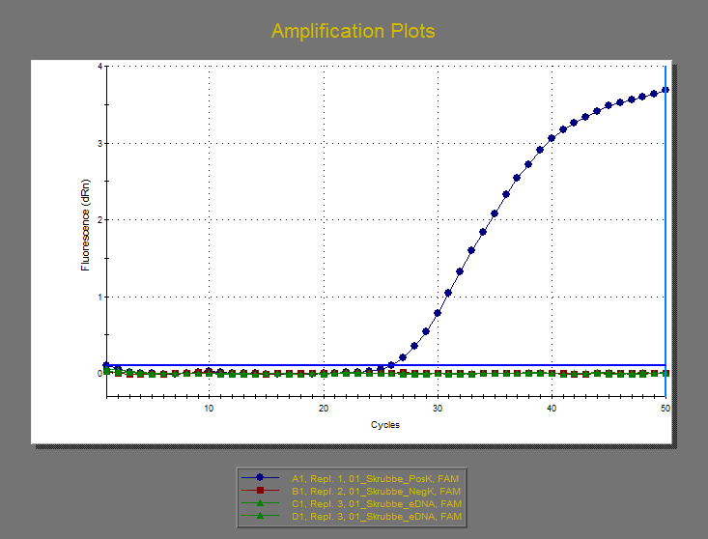
Amplification Plots
20210924_DL2021040_SktAnnaeGymOrdrupGym.mxp

Slide 2
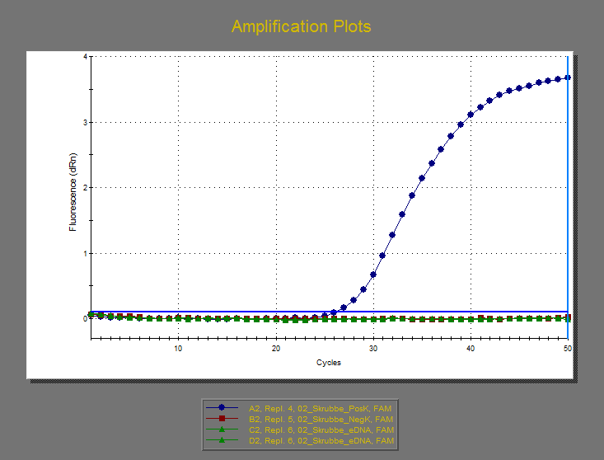
Amplification Plots
20210924_DL2021040_SktAnnaeGymOrdrupGym.mxp

Slide 3
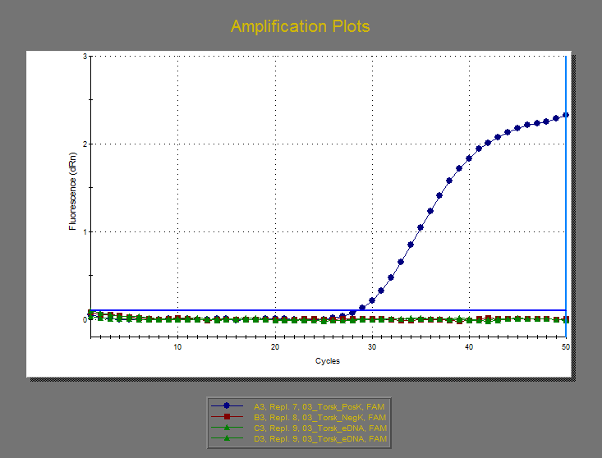
Amplification Plots
20210924_DL2021040_SktAnnaeGymOrdrupGym.mxp

Slide 4
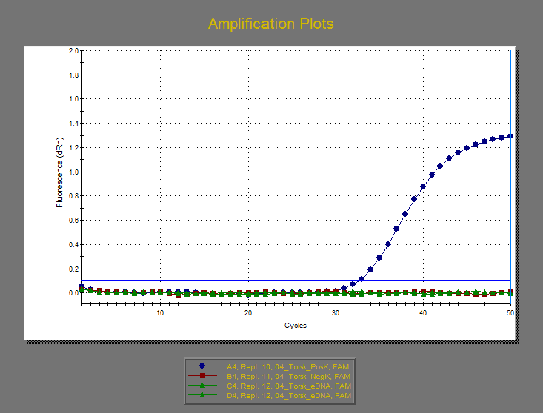
Amplification Plots
20210924_DL2021040_SktAnnaeGymOrdrupGym.mxp

Slide 5
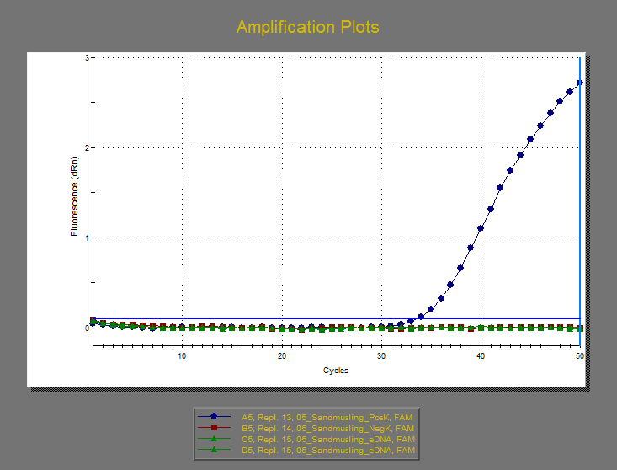
Amplification Plots
20210924_DL2021040_SktAnnaeGymOrdrupGym.mxp

Slide 6
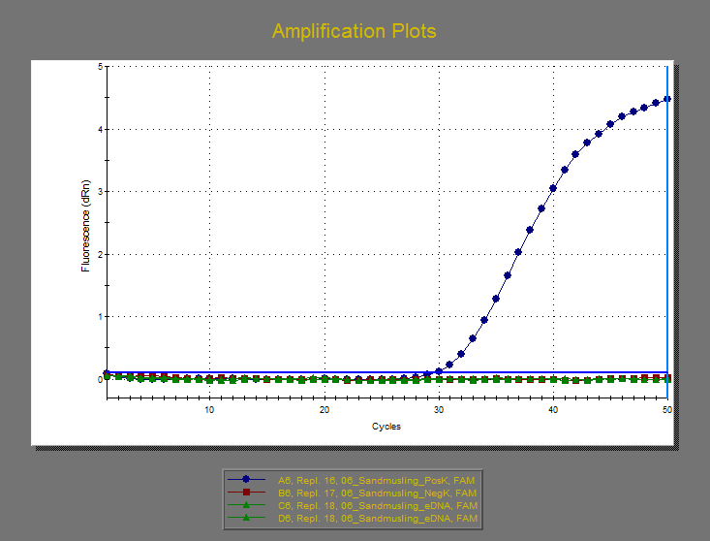
Amplification Plots
20210924_DL2021040_SktAnnaeGymOrdrupGym.mxp

Slide 7
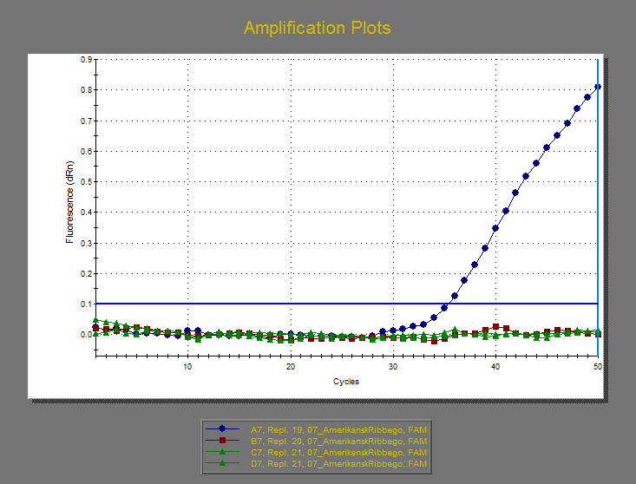
Amplification Plots
20210924_DL2021040_SktAnnaeGymOrdrupGym.mxp

Slide 8
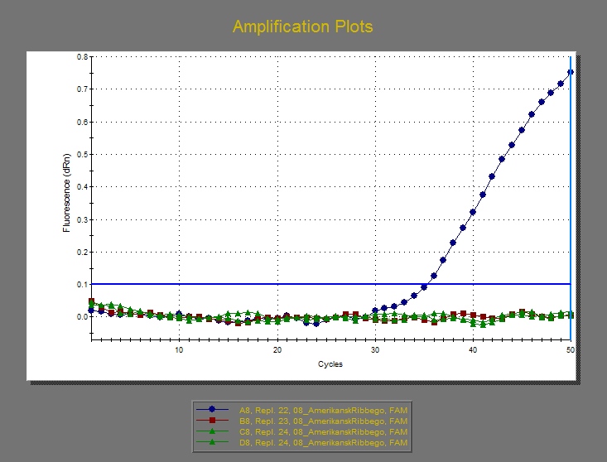
Amplification Plots
20210924_DL2021040_SktAnnaeGymOrdrupGym.mxp

Slide 9
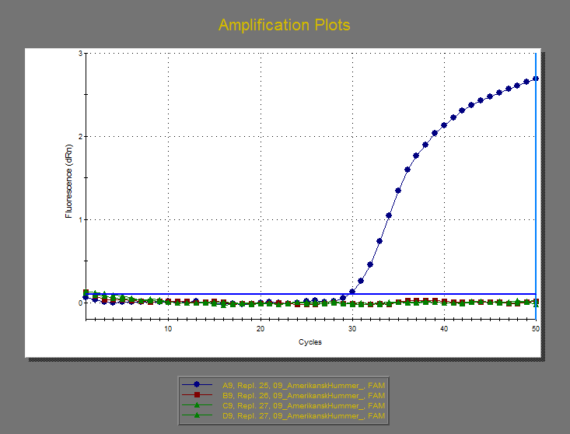
Amplification Plots
20210924_DL2021040_SktAnnaeGymOrdrupGym.mxp

Slide 10
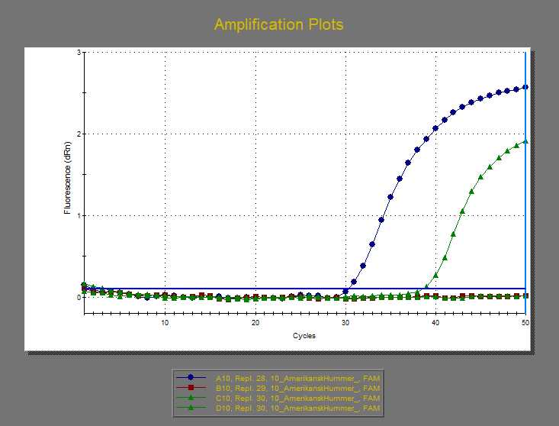
Amplification Plots
20210924_DL2021040_SktAnnaeGymOrdrupGym.mxp

Slide 11
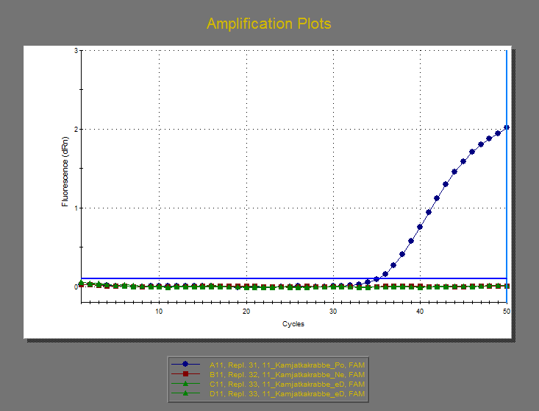
Amplification Plots
20210924_DL2021040_SktAnnaeGymOrdrupGym.mxp

Slide 12
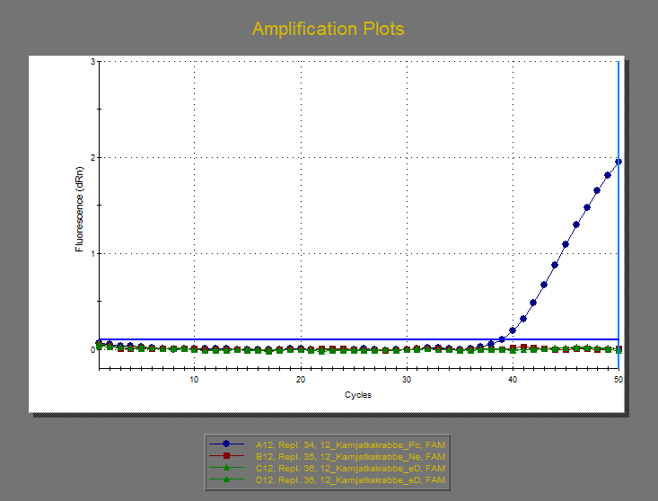
Amplification Plots
20210924_DL2021040_SktAnnaeGymOrdrupGym.mxp

Slide 13
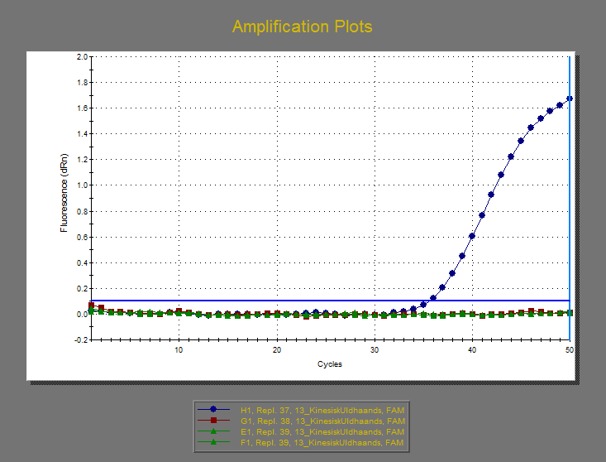
Amplification Plots
20210924_DL2021040_SktAnnaeGymOrdrupGym.mxp

Slide 14
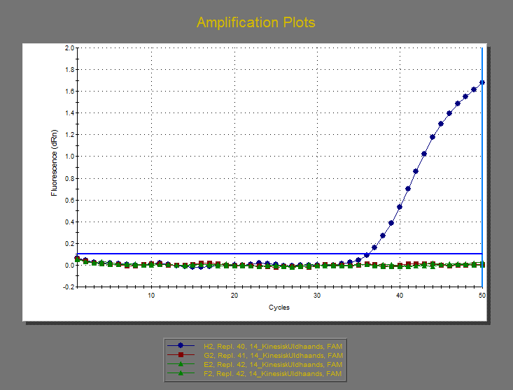
Amplification Plots
20210924_DL2021040_SktAnnaeGymOrdrupGym.mxp

Slide 15
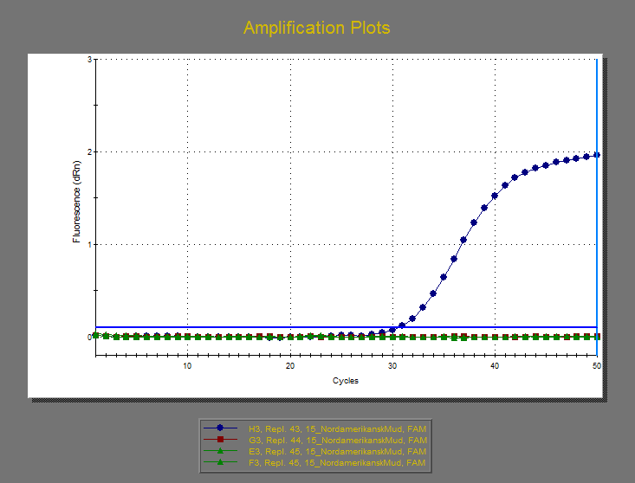
Amplification Plots
20210924_DL2021040_SktAnnaeGymOrdrupGym.mxp

Slide 16
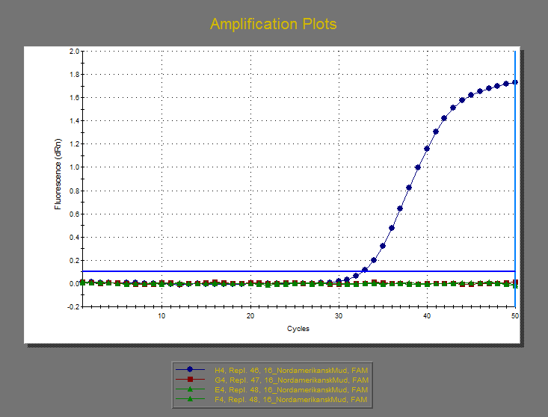
Amplification Plots
20210924_DL2021040_SktAnnaeGymOrdrupGym.mxp

Slide 17
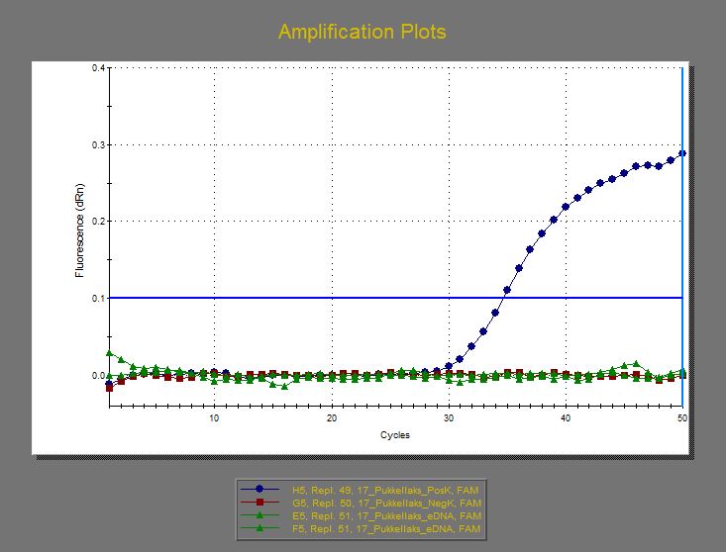
Amplification Plots
20210924_DL2021040_SktAnnaeGymOrdrupGym.mxp

Slide 18
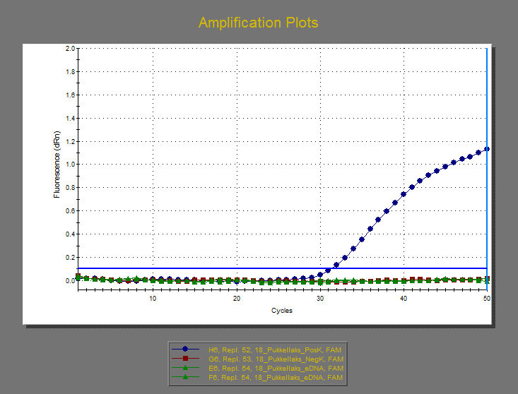
Amplification Plots
20210924_DL2021040_SktAnnaeGymOrdrupGym.mxp

Slide 19
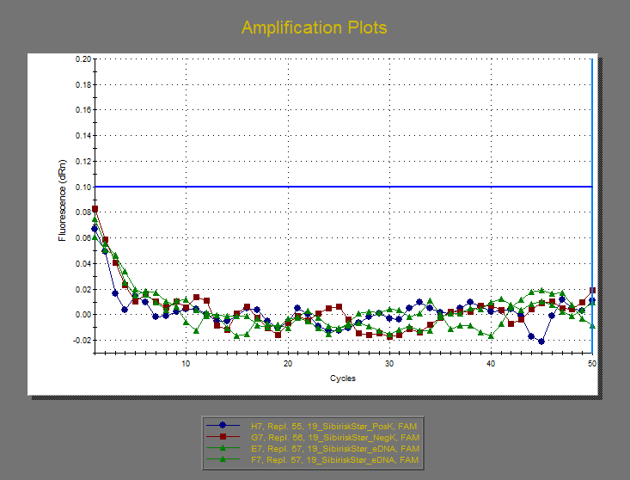
Amplification Plots
20210924_DL2021040_SktAnnaeGymOrdrupGym.mxp

Slide 20
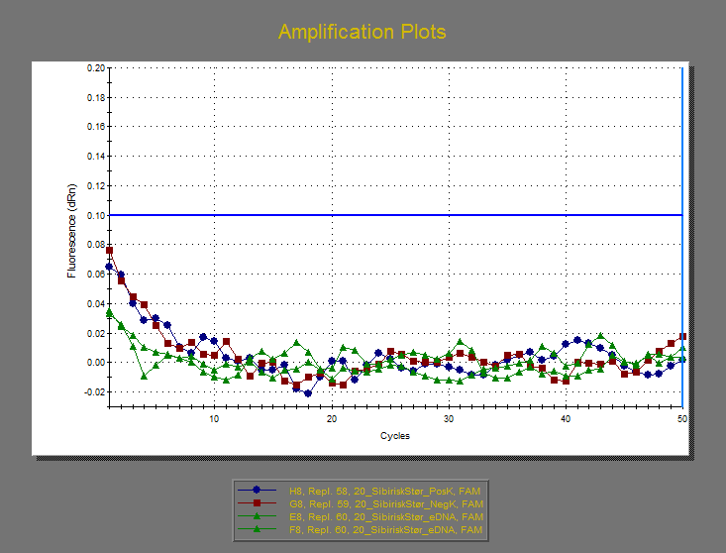
Amplification Plots
20210924_DL2021040_SktAnnaeGymOrdrupGym.mxp

Slide 21
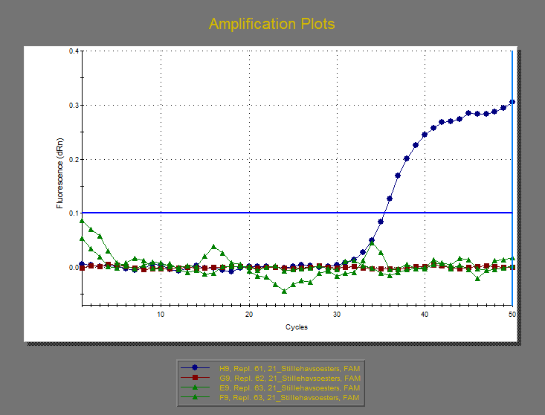
Amplification Plots
20210924_DL2021040_SktAnnaeGymOrdrupGym.mxp

Slide 22
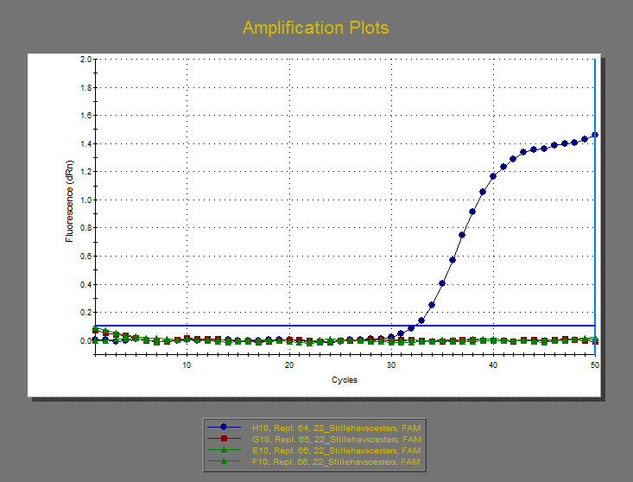
Amplification Plots
20210924_DL2021040_SktAnnaeGymOrdrupGym.mxp

Slide 23
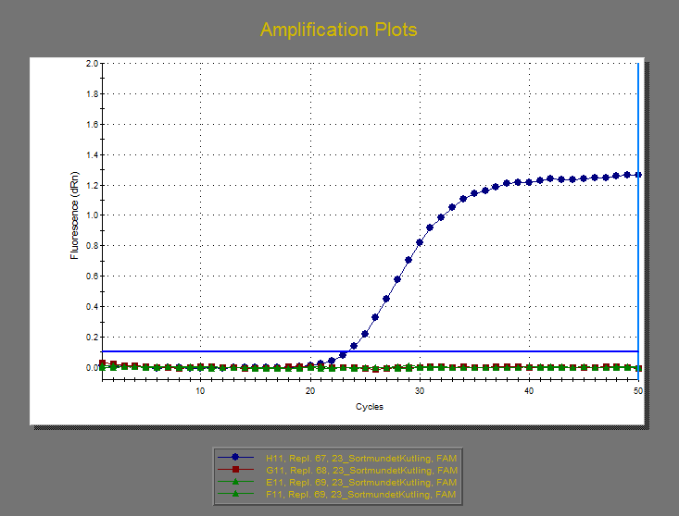
Amplification Plots
20210924_DL2021040_SktAnnaeGymOrdrupGym.mxp

Slide 24
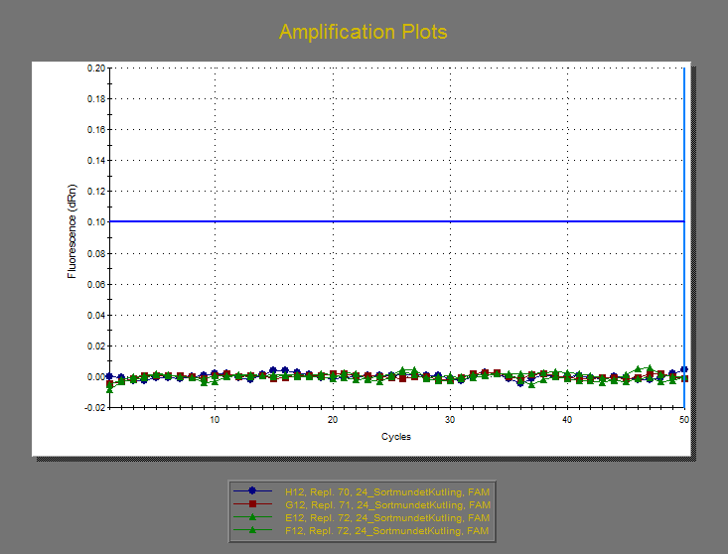
Amplification Plots
20210924_DL2021040_SktAnnaeGymOrdrupGym.mxp

